Slide 1
Bank CRM Churn Analysis
Customer Segmentation, Risk Analysis, and Retention Strategies
By: AYUSHI SINGH
On: 16th June 2025

Slide 2
Objective of the Project
Understand churn patterns in the bank's customer base
Segment customers based on key demographics and behavior
Identify risk indicators for churn
Recommend strategies to improve customer retention and lifetime value

Slide 3
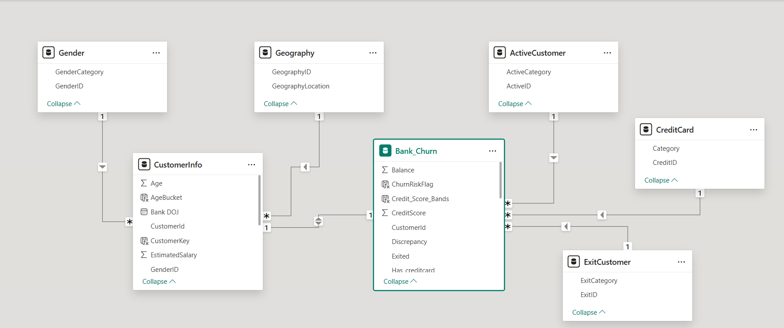
Database Schema

Slide 4
Dataset Overview
Total Customers: 10,000
Key Tables Used:
Bank_Churn
CustomerInfo
Gender
Geography
CreditCard / ExitCustomer / ActiveCustomer
Variables: Age, Tenure, Balance, Estimated Salary, Credit Score, NumOfProducts, IsActiveMember, HasCrCard

Slide 5
Tools Used
I utilized a combination of tools to manage, analyze, and visualize the data:
Excel: This tool provided an overview of the data, which I later converted to CSV format for import into SQL and other analysis tools.
SQL: I used SQL to extract and query data from databases efficiently.
Power BI: This tool was used for data cleaning, transformation, and creating interactive dashboards to generate actionable insights.
These tools streamlined the analysis process & enabled the development of clear and actionable insights for our CRM strategy.

Slide 6
Data Cleaning and Preparation
Checked for null/missing values using Power Query
Used "Column Quality" and "Column Distribution"
Applied:
Replace nulls with median (numeric)
Mode or "Unknown" for categorical
Excluded rows with missing critical dates
Created new fields: AgeBucket, TenureBucket, ChurnRiskFlag

Slide 7
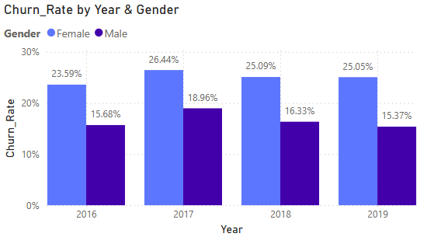
Churn Rate Overview
Overall Churn Rate: 20.37%
Churn Rate by Year & Gender:
Female churn: consistently 23-26%
Male churn: consistently 15-18%

Slide 8
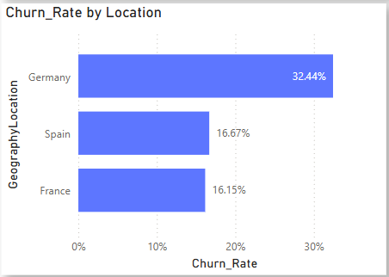
Churn Rate Overview
Churn Rate by Region:
Highest: Germany (32.44%)
Lowest: France (16.15%)

Slide 9
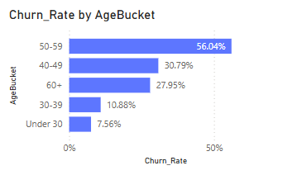
Segmentation by Demographics
Age Buckets: Highest churn in 50–59 group (56.04%)

Slide 10
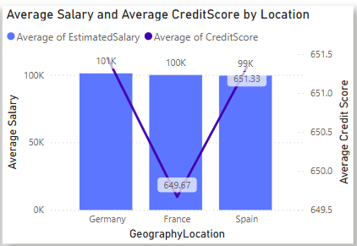
Segmentation by Demographics
Location: Germany shows high churn despite high salaries

Slide 11
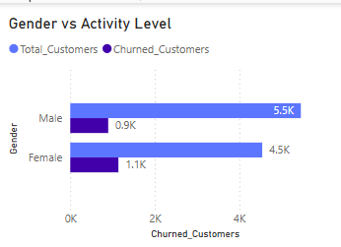
Segmentation by Demographics
Gender: Female customers churn more than males

Slide 12
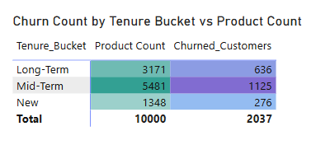
Segmentation by Behaviour
Tenure Buckets:
Mid-term (2–5 years) = highest churn volume
Long-term = more loyal
Activity Status:
Inactive members show higher churn
Product Count:
1-product users churn the most

Slide 13
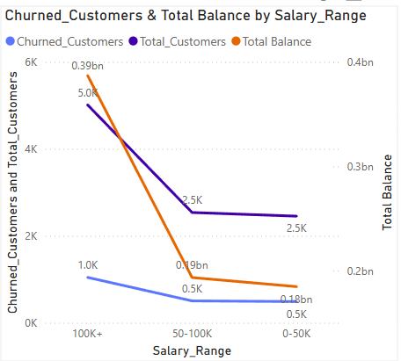
Segmentation by Financial Strength
Balance vs Salary buckets show no strong correlation with churn
High-balance customers also exit, especially if poorly engaged
Credit score is a more reliable churn indicator than salary

Slide 14
Conditional Formatting & Churn Flag
ChurnRiskFlag Logic:
Score based on Age, Tenure, Products, Activity
High Risk = 3+, Moderate = 2, Low < 2
Applied color-based formatting:
High = Red, Moderate = Yellow, Low = Green
Used in the dashboard to visually isolate vulnerable customers

Slide 15
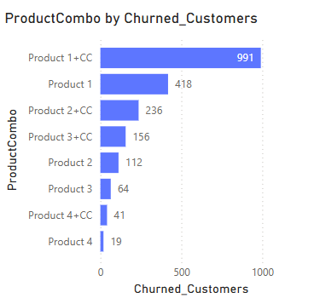
Product Affinity & Churn
Product 1 + Credit Card = highest churn combo
Customers with only 1 product hold the highest total balance
Churn drops as product count increases
Customers with 4 products show zero churn

Slide 16
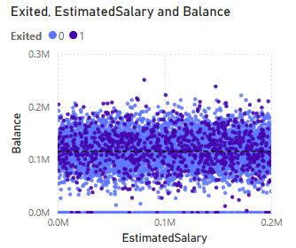
Retention Risk: Balance Outliers
Retained customers mostly have balances between ₹60K-₹180K
Outliers:
Some have 0 balance but haven't exited
High-value retained customers have >₹200K
Suggests further potential for upselling or account optimization

Slide 17
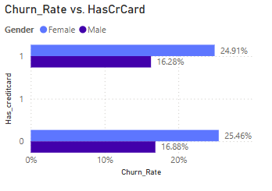
Churn Risk by Credit Card Ownership
Minor difference in churn with vs without credit card:
Females: 24.91% (with) vs 25.46% (without)
Males: 16.28% (with) vs 16.88% (without)
Indicates the current reward system has limited retention impact

Slide 18
Insights Summary
Female and mid-tenure customers are at highest risk
High-balance customers are churning despite their value
Credit card rewards are not driving strong retention
Germany has highest churn despite high salary levels

Slide 19
Recommendations
Targeted outreach for the 40–59 age group and females
Rebuild rewards program: tiered, personalized, gamified
Launch location-specific retention teams (Germany/France)
Improve onboarding and cross-sell for 1-product customers
Use ChurnRiskFlag in dashboards to trigger proactive calls

Slide 20
Predictive Modelling (Future Scope)
Suggest a logistic regression or decision tree model
Use features like:
Age, Tenure, Products, Activity, Balance, Credit Score
Predict churn probability and integrate with visual dashboards
Enables targeted, real-time retention interventions

Slide 21
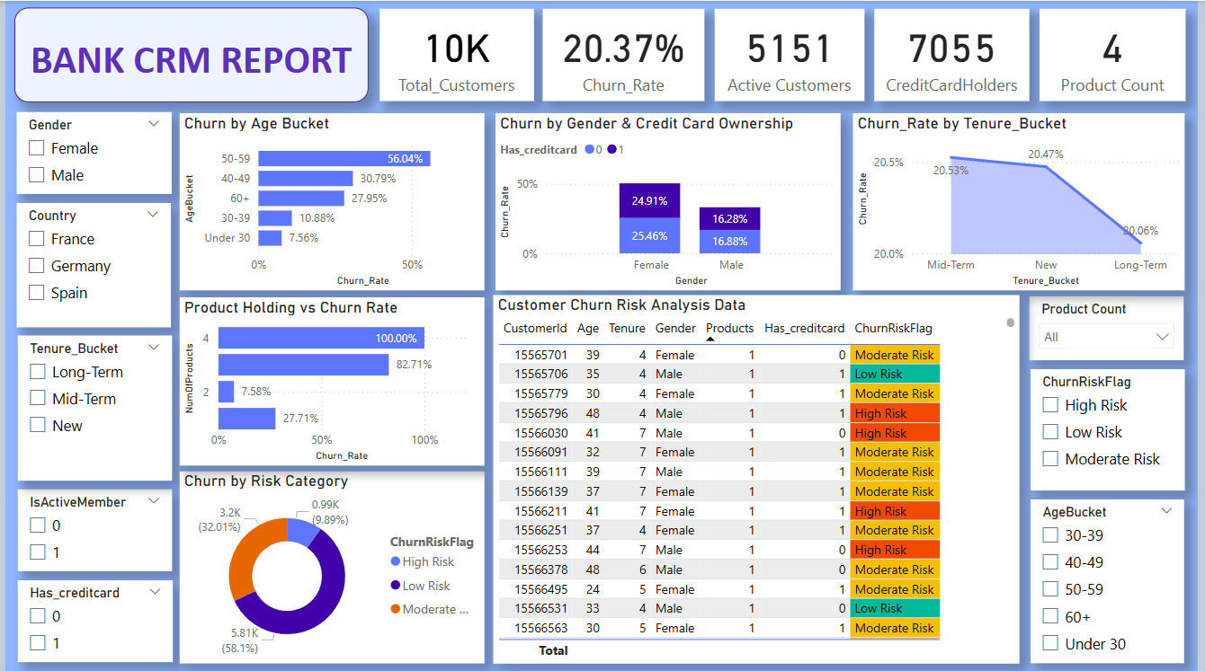
Dashboard

Slide 22
Power BI Dashboard Summary
Interactive KPIs: Churn%, Active vs Exited, High Risk Customers
Filters by Age, Gender, Geography, Tenure
Visuals:
Map, bar charts, churn trends, segmentation matrix
ChurnRiskFlag-based tables with conditional formatting

Slide 23
Final Takeaways
Churn is not random: it follows clear patterns
Demographic + behavioral segmentation is essential
Retention efforts must be data-driven and dynamic
With proactive strategies, high-value customers can be retained

Slide 24
THANK YOU!!

